Slide 1
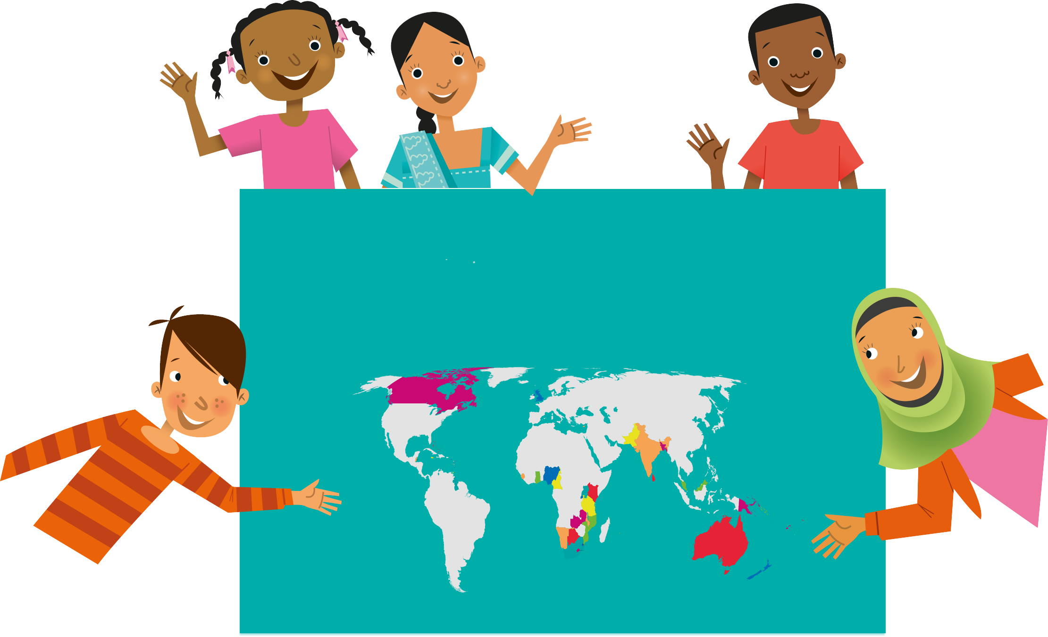
Does an opportunity to have your creative voice heard across the world excite you?
Are you inspired by your community’s response to a challenging year?
Do you want to express your experience or your visions for the future to a global audience?

Slide 2
What is the QCEC?
Launched 140 years ago, it is the world’s oldest international writing competition for schools.
One of the largest creative writing programmes for under-18s, inviting entries from all 56 nations of the Commonwealth.
An opportunity for young people to share their views and experiences on a global platform
Notes:
Bullet 1: The Queen’s Commonwealth Essay Competition, or QCEC, with 160,000 entries since 2010
Bullet 2: Previous winners include the Prime Minister of Singapore and the Pulitzer Prize Winner, Mei Fong, who we will hear from later.
Bullet 3: by writing freely on an important current topic

Slide 3
What is the Royal Commonwealth Society?
An international network of individuals and organisations committed to improving the lives and prospects of Commonwealth citizens across the world
Promotes the value, and values, of the Commonwealth through youth empowerment, education and advocacy
Notes:
Bullet 1: The RCS was founded in 1868 and has run the QCEC since its creation

Slide 4
Why should you enter?
Speak out and be heard! Your voice will be listened to by a global audience
Get involved! Your input could influence a better future across 56 countries
Share your unique experience! Tell the world how your local community responds to global issues
Be a mover and a shaker! Challenge norms and paint your visions for the future
Generate exciting career opportunities! Start by actively participating in social issues
Notes:
Bullet 1: This is a rare opportunity for you to use your voice for an audience to this scale
Bullet 2: You are an extremely valuable member of the Commonwealth
Bullet 3:
Bullet 4:
Bullet 5: Conscious and active participation in social issues is the first step on the path toward an exciting and rewarding career

Slide 5
What skills will you develop?
Creative written English and storytelling
Critical thinking skills to reflect on your local and international world
Thinking creatively and empathising with other people’s experiences
Gaining confidence to share ideas with thousands of readers across the globe
Experimenting freely with different genres and forms of writing

Slide 6
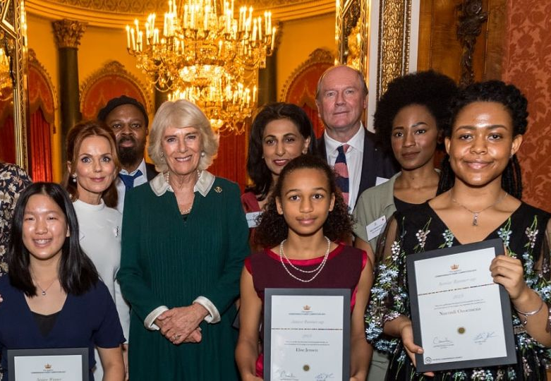
What could you win?
Winners and Runners-up are brought to London for a Winners’ Week: a programme of cultural and educational activities, typically including an Awards Ceremony at Buckingham Palace!
Winners’ Week is different each year, but past activities have included:
Meetings with high-profile literary figures, diplomats, and high-level decision-makers
Creative writing workshops with well-known authors
A visit to Cambridge University
Exploring the sights of London, including activities and evening productions at some of London’s oldest theatres
Recording entries at BBC Broadcasting House
Every young person who enters receives a Certificate of Participation
Gold, Silver and Bronze Certificates are awarded to excellent entries
Notes:
Bullet 1:
Bullet 2:
Bullet 3:
Bullet 4: such as Westminster Abbey, with guided tours of London landmarks, and boat tours of the river Thames
Bullet 5: such as workshopping Romeo and Juliet on the stage of Shakespeare’s Globe Theatre or visiting backstage at the National Theatre
EXTRA: Winners have requested to visit Harry Potter World, or the Audi car show. Visit a dream location of your own…

Slide 7
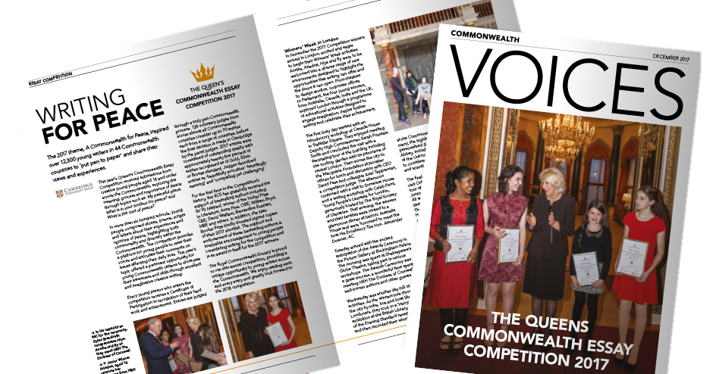
Where will your writing be shared?
Winning entries are:
Published in Voices, the Royal Commonwealth Society’s magazine, and in our online blog.
Turned in to an eBook and uploaded to Worldreader.
Read and broadcasted by influential and well-known Commonwealth figures.
Notes:
Bullet 1:
Bullet 2: Worldreader provides reading apps which allow anyone, anywhere to access ebooks. They reach readers in 46 countries, providing them with 42,233 book titles in 43 languages.
Bullet 3: The entry of last year’s Senior Runner-Up from India, Ananya Mukerji, was read on Instagram by Bollywood star, Kareena Kapoor Khan, and has been watched nearly two million times! Ananya’s piece was also printed in a number of major Indian news publications and websites.

Slide 8
It all starts with a story…
“Keep writing; it will change your life, and you can change the world.”
- Mei Fong, Pulitzer Prize-winning writer and 1989 QCEC Winner
Notes:
Now let’s watch a short clip and hear from some of the previous winners and runners up of the QCEC, as well as some supporters of the competition.

Slide 9
2023 Theme:
A Youth-Powered Commonwealth
This year’s theme is A Youth-Powered Commonwealth.
To mark the 50th Anniversary of the Commonwealth Youth Programme, Commonwealth Heads of Government declared 2023 a year dedicated to youth-led action for sustainable and inclusive development and called on a renewal and strengthening of our commitment to youth engagement and empowerment. Young people are asked to explore the power they hold within the global community and how it can be harnessed to make a meaningful impact in the world.
Notes:
Each year, the QCEC seeks to explore a topical theme for the Commonwealth’s young people. Previous years have seen submissions on the environment, inclusion, and enterprise.
This year, we want young people to explore how they, and their communities, experienced the Covid-19 pandemic.

Slide 10
2023 Theme: A Youth-Powered Commonwealth
SENIOR CATEGORY Word count: 1500
As Head of the Commonwealth, His Majesty The King is opening an international conference on the importance of young people in decision making. Write his speech.
Does age matter?
The 2023 Year of Youth was a moment of significant social change – what was its impact on the world?
Script a dialogue between two people, with contrasting viewpoints, on an issue that divides generations.

Slide 11
Activity: Spark a Story!
Objective: Use your imagination to consider different perspectives
Think of a social issue that you feel passionately about.
What are young people doing on a local and global scale to address this issue?
How does their age affect the impact they are able to have? Does it give them a unique viewpoint?
Write a story, poem or essay based on these observations.
FANCY A CHALLENGE?
With the same story in mind, now write it from a different point of view! If you wrote about your chosen social issue from the perspective of a young person, what would their grandparents think about the same issue?

