Slide 1
Does an opportunity to have your creative voice heard across the world excite you?
Are you inspired by your community’s response to a challenging year?
Do you want to express your experience or your visions for the future to a global audience?

Slide 2
What is the QCEC?
Started 140 years ago, it is the world’s oldest international writing competition for schools.
One of the largest creative writing programmes for under-18s, inviting entries from all 56 nations of the Commonwealth.
An opportunity for young people to share their views and experiences on a global platform
Notes:
Bullet 1: The Queen’s Commonwealth Essay Competition, or QCEC, with 160,000 entries since 2010
Bullet 2: Previous winners include the Prime Minister of Singapore and the Pulitzer Prize Winner, Mei Fong, who we will hear from later.
Bullet 3: by writing freely on an important current topic

Slide 3
What is the Royal Commonwealth Society?
An international network of individuals and organisations committed to improving the lives and prospects of Commonwealth citizens across the world
Promotes the value, and values, of the Commonwealth through youth empowerment, education and advocacy
Notes:
Bullet 1: The RCS was founded in 1868 and has run the QCEC since its creation

Slide 4
Why should you enter?
Speak out and be heard! Your words will be listened to by a global audience
Use your most limitless tool: your imagination! Your ideas can change the world
Share your unique experience! Tell the world how your local community responds to global issues
Predict the future! Paint your own individual vision for the future
Notes:
Bullet 1: This is a rare opportunity for you to use your voice and be listened to by people across the world
Bullet 2: You are an extremely valuable member of the Commonwealth, and your input within this international community could influence a better future across 54 countries
Bullet 3: Perhaps there is a person or group you are particularly inspired by and you want to share their story
Bullet 4:

Slide 5
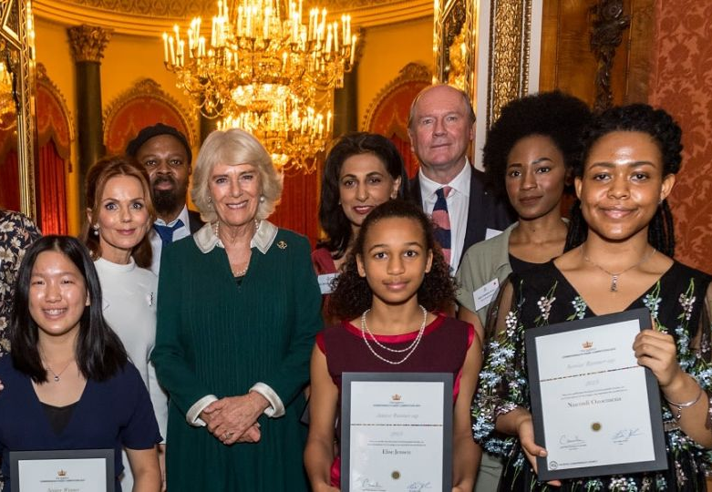
What could you win?
Winners and Runners-up are brought to London for a Winners’ Week: a programme of cultural and educational activities, typically including an Awards Ceremony at Buckingham Palace!
Winners’ Week is different each year, but past activities have included:
Creative writing workshops with well-known authors
A visit to Cambridge University
Exploring the sights of London with boat tours of the River Thames
Activities and evening productions at some of London’s oldest theatres
Visiting a dream location such as Harry Potter World
Every young person who enters receives a Certificate of Participation
Gold, Silver and Bronze Certificates are awarded to excellent entries
Notes:
Bullet 4: such as workshopping Romeo and Juliet on the stage of Shakespeare’s Globe Theatre or visiting backstage at the National Theatre

Slide 6
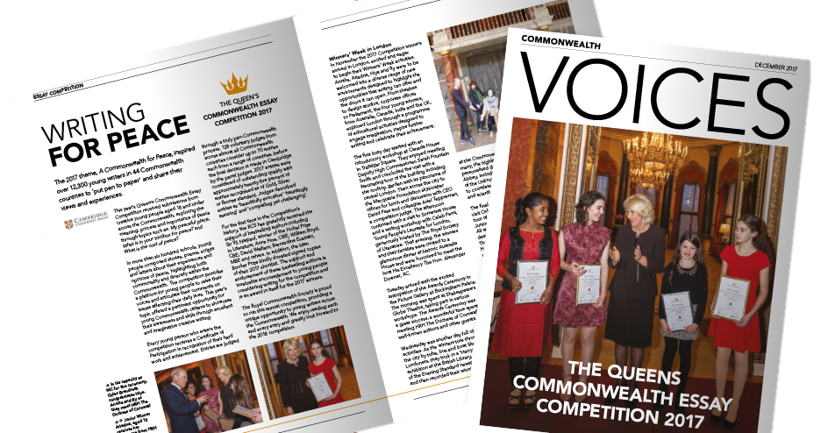
Where will your writing be shared?
Winning entries are:
Published in Voices, the Royal Commonwealth Society’s magazine, and in our online blog.
Turned in to an eBook and uploaded to Worldreader.
Read and broadcasted by influential and well-known Commonwealth figures.
Notes:
Bullet 1:
Bullet 2: Worldreader provides reading apps which allow anyone, anywhere to access ebooks. They reach readers in 46 countries, providing them with 42,233 book titles in 43 languages.
Bullet 3: The entry of last year’s Senior Runner-Up from India, Ananya Mukerji, was read on Instagram by Bollywood star, Kareena Kapoor Khan, and has been watched nearly two million times! Ananya’s piece was also printed in a number of major Indian news publications and websites.

Slide 7
It all starts with a story…
“Keep writing; it will change your life, and you can change the world.”
- Mei Fong, Pulitzer Prize-winning writer and 1989 QCEC Winner
Notes:
Now let’s watch a short clip and hear from some of the previous winners and runners up of the QCEC, as well as some supporters of the competition.

Slide 8
2023 Theme:
A Youth-Powered Commonwealth
This year’s theme is A Youth-Powered Commonwealth
To mark the 50th Anniversary of the Commonwealth Youth Programme, Commonwealth Heads of Government declared 2023 a year dedicated to youth-led action for sustainable and inclusive development and called on a renewal and strengthening of our commitment to youth engagement and empowerment. Young people are asked to explore the power they hold within the global community and how it can be harnessed to make a meaningful impact in the world.
Notes:
Each year, the QCEC seeks to explore a topical theme for the Commonwealth’s young people. Previous years have seen submissions on the environment, inclusion, and enterprise.
This year, we want young people to explore how they, and their communities, experienced the Covid-19 pandemic.

Slide 9
2023 Theme: A Youth-Powered Commonwealth
JUNIOR CATEGORY (under 14 years of age) Word count: 750
In fiction and throughout history, young people have performed numerous acts of heroism. Choose your favourite young hero and write to them about why you admire them.
What is your youthful superpower, and how can it make a positive difference to the world?
You have been stranded on a planet where everyone is 18 or under. Journal your experience.
Why does your voice matter?

Slide 10
Activity: Give Me Five!
Objective: Practise planning stories and identifying key plot points
Start with a closed hand. Think of a superhero and explain their superpowers to your partner in 5 key points. Open one finger each time you start a new point. When you have finished your 5 points, your hand should be primed for a whopping high five with your partner!
Create a story answering these magic five questions about your superhero: Who are they? What event takes place that needs their help? Where and when does it take place? How do their superpowers benefit their community?
Now, create your own story outline using the same method: each time you start a new point, raise a finger.
TOP TIP!
Use sequence words such as first, then, next, after that, finally to create a clear structure for your story and make it exciting for your listener.

